Slide 1

McDonald’s
Order System
Student Name | Student ID
Ling Hui Shan | D190009A
Aw Rui Ying | D190072A
Ivy Tee Yee Wei | D190040A
William Gwee Jian Hui | D190067A

Slide 2
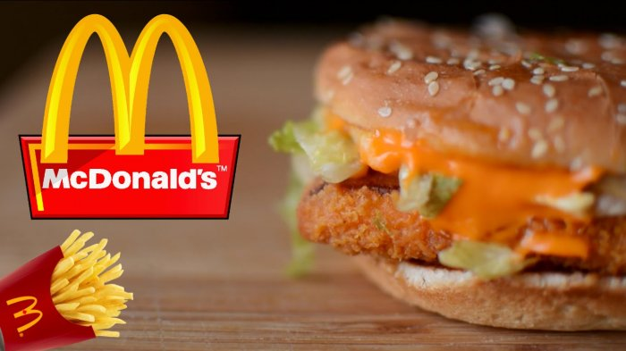
Welcome to McDonald’s Order System

Slide 3
01
Booking
目录/CONTENT
02
Receipt
03
Exit

Slide 4
01
Booking

Slide 5




01
Booking
Phone
Number
Name
Date
Email

Slide 6



Payment Method
Cash
Bank Card

Slide 7




Buy method
Eat Here
Take Away
Delivery
Cancel Order

Slide 8

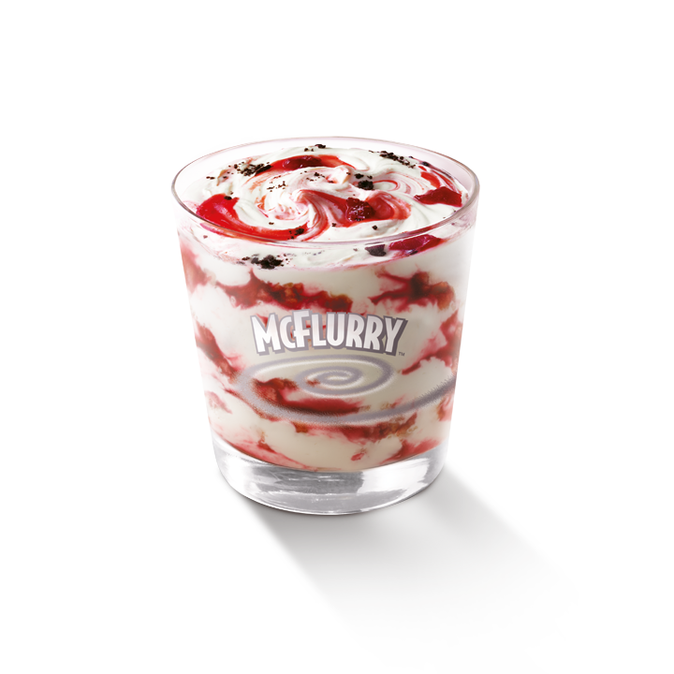

01
Menu
dessert
Happy meal
Package

Slide 9
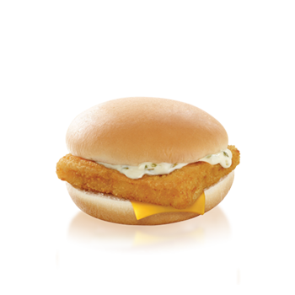

01
Menu
Ala Carte
Drink

Slide 10




Quantity

Slide 11
02
Receipt

Slide 12
02
Receipt
01
Name
Phone Number
02
03
Date
Email
04
05
Total Price

Slide 13
03
Exit

